Slide 1
Healthy Moms. Strong babies.
Volunteer Appreciation & Gratitude Toolkit
By: Morghan Hyatt (Volunteer Engagement and Mobilization Intern)

Slide 2
Purpose:
Volunteers drive our work to empower families. Without their critical support in time, energy and expertise, March of Dimes couldn’t do the work it needs to do to fight for the health of all moms and babies. Elevating and celebrating volunteers year-round is an important element of this work.
This guide provides ideas to elevate and celebrate volunteers year-round and includes information about March of Dimes recognition/awards programs.

Slide 3
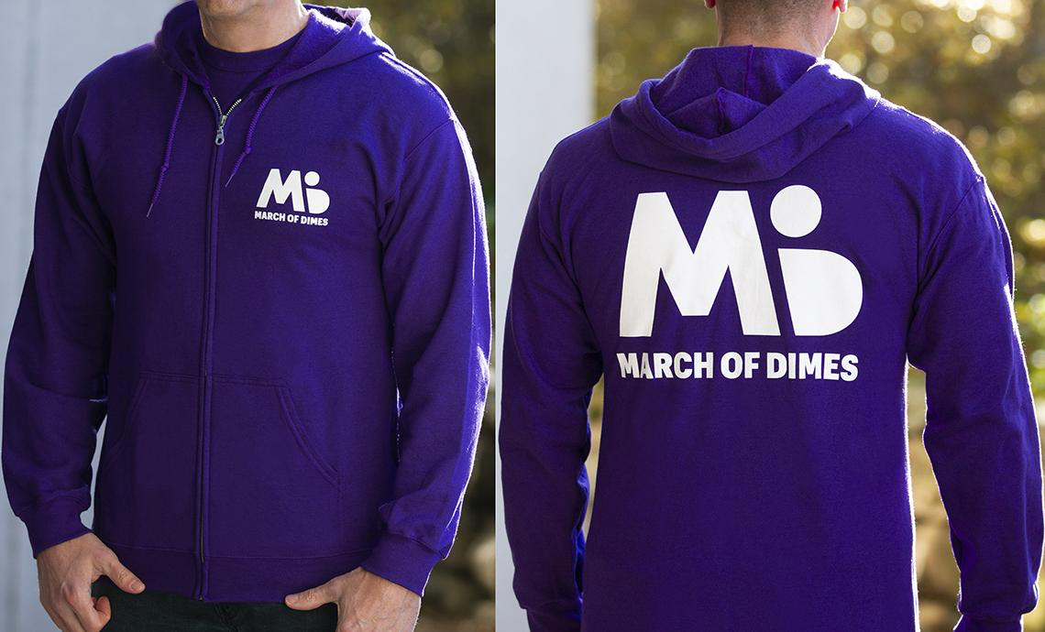
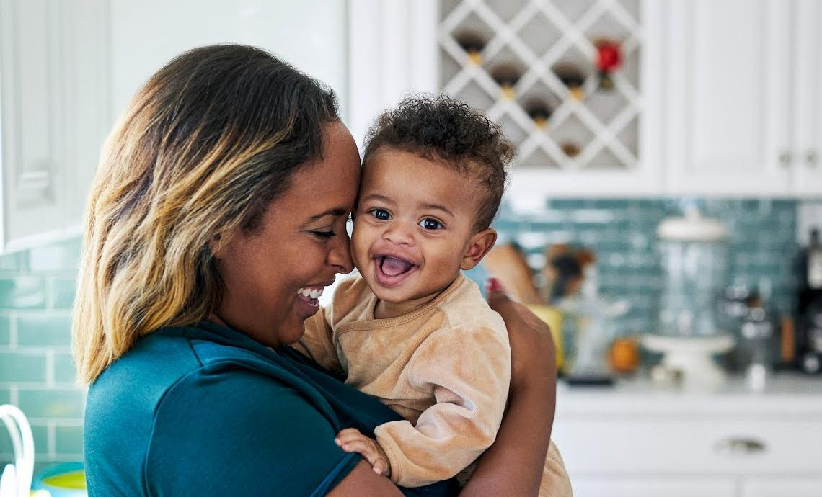
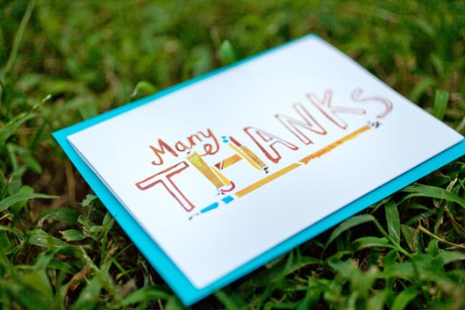
Gratitude & Appreciation Grab and go’s:
Click one of the pictures to learn more!
Gratitude gift
MOD Paraphernalia
Staff to Volunteer
Volunteer to Volunteer
grat·i·tude: The quality of being thankful; readiness to show appreciation for and to return kindness
Gratitude allows people to acknowledge the goodness in their lives, helps people feel more positive emotions, relish good experiences, improves their health, deal with adversity and build strong relationships through virtual, digital, personal and snail mail outlets.
Honor with Appreciation
Gratitude successories
Host a gratitude event
Thank you e-cards

Slide 4
How Gratitude and appreciation go hand in hand
Research based on the workplace
Ideal times to say thank-you:
The correlation between job satisfaction and a primary need for positive work environments have been cultivated through daily expressions of appreciation and gratitude shown between coworkers. Institutionalized gratitude is defined as, “gratitude that is culturally embedded within the organization, through its people, policies, and practices, such that thankfulness and appreciation are customary features of daily work life”. There has been an increasing need for people to show gratitude just as there has been an overwhelming need to experience gratitude. For these reasons, it is important for measures to be taken in order to increase job satisfaction and stimulate appreciation in employees which reinforces a positive atmosphere in the workplace.
January: Martin Luther King Weekend
April: Volunteer Appreciation Week & Volunteer Appreciation Day
May: Mother’s Day
June: Father’s Day
September: 9/11 National Day of Remembrance and Service
October: Make a Difference Day
November: Prematurity Awareness Month
December: 12/5 International Volunteer Day
Gratitude is perceived as a construct that serves as an umbrella to things such as appreciation. Although gratitude can be subjective, it can include conceptual elements to express genuine ways of appreciation. Simple gestures and valuable interpersonal acknowledgments are essential ways in which gratitude is incorporated in the workplace.
Recalling good things that may have been the result of an increase of happiness in the workplace can be ways of self-reporting gratitude. There are numerous instances where a coworker or manager may have shown appreciation, in this case, it is important that these instances be acknowledged. Acknowledging this appreciation in some ways can provide positive feedback along with a positive environment.
Sources:
https://positivepsychology.com/gratitude-research/#psychology-gratitude
https://search-proquest-com.authenticate.library.duq.edu/central/docview/1692238363/7D89ED436AC94667PQ/3?accountid=10610
https://web-a-ebscohost-com.authenticate.library.duq.edu/ehost/detail/detail?vid=2&sid=314665ca-0dcc-47bb-b530-923d119886db%40sdc-v-sessmgr02&bdata=JnNpdGU9ZWhvc3QtbGl2ZQ%3d%3d#AN=134716224&db=afh
Notes:
Research portion

Slide 5
National Volunteer appreciation Week: a perfect time to say thank-you!
National Volunteer Week (NVW) is an opportunity to celebrate the impact of volunteer service and the power of volunteers to tackle society’s greatest challenges, to build stronger communities and be a force that transforms the world. It is usually celebrated for a week during the month of April.
National Volunteer Week is a moment in time to honor, celebrate and uplift the volunteers that lead the fight for the health of all moms and babies. Recognizing and thanking volunteers who lend their time, talent and voice to make a difference in their communities.

Slide 6
Zoom Party Starter Kit:
Intro (1-2mins): host introduces themselves and the reason for the zoom party
Ice breaker (5-10 mins): each person can share their name and a fun fact about themselves
Share your screen (10 mins): can have a power-point to show gratitude/appreciation or a tribute video
Breakout rooms (10 mins): provide fun games or questions for people to answer
Big takeaway (5 mins): wrap up the games or discussion and reiterate the reason for the zoom party/celebration
*Zoom allows any user to create an account and hold meetings up to 40 minutes*
Want to have a Zoom Party?
Here’s how
Create your own space for interaction and connectivity

Slide 7
Zoom party Break Out Room Game ideas:
Gratitude Pictionary:
Each person in the breakout room draws something they are grateful for or how they show appreciation. (The picture cannot contain words, letters or numbers.)
Each person from the group will have a chance for someone to guess what that picture means in 60 seconds!
The Grateful Game:
Each person in the breakout room can share what they are grateful for/appreciative of with these prompts
I am grateful for/appreciative of these 3 people who…
I am grateful for/appreciative of these 3 things in my life that…
I am grateful for/appreciative of these 3 friends through MOD that…

Slide 8
Still Can’t Think of any ideas to express gratitude?
Here’s a few!
15 clever and innovative ideas based on gratitude
Click one of the purple dots to learn more!
Hand-written notes just to say thank you
Post a LinkedIn shout out to recognize an outstanding volunteer
A tribute video to exhibit appreciation

Slide 9
Above all else…Remember
If you consistently share your thanks and appreciation during these three points in every event, your volunteers will, no doubt, hear your gratitude. These three points are:
1. Thank volunteers as they arrive or when they appear in a zoom meeting
- Thanking them for simply showing up will immediately help them feel needed and recognized.
2. Thank them as you talk about your organization's mission statement
- ( i.e. “We couldn’t do this without volunteers so thank you for being here today!”)
3. Thank them at the end of their shift or at the end of a zoom meeting
- (i.e. “Wow! Thank you everyone for your help. Today we made 200 lunches for those in need/sorted through 60 pounds of donations!”)

Slide 10
Volunteer Leadership Awards
Elaine Whitelaw Volunteer Service Award
Mission Impact Volunteer Leadership Award
Nomination period: June/July annually
Market Volunteer of the Year Award
Paula Ransom Volunteer Partner Award
Who Can Nominate? Any staff member or volunteer may nominate one or more volunteers for any category. We ask that volunteers nominating other volunteer leaders alert their staff partner.
Period of Volunteer Service: All awards recognize service over the past 18 months.
March for Babies Step Up! Volunteer Leadership Award
See award descriptions and a promotion video in the Volunteer Learning Center!

