Slide 1
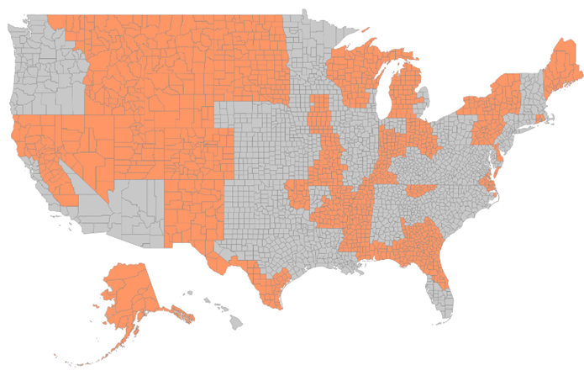
Coast to coast region
Whole State Support
Alaska
Arkansas
Colorado
Delaware
Idaho
Indiana
Maine
Mississippi
Montana
Nevada
New Hampshire
New Mexico
North Dakota
Rhode Island
South Dakota
Utah
Vermont
Wyoming
Additional Support By State & Large Cities
CALIFORNIA: Sacramento, Fresno, Modesto, Bakersfield
FLORIDA: Jacksonville, Gainesville, Panama City, Pensacola, Tallahassee, Orlando, Ocala, Daytona Beach
GEORGIA: Augusta, Brunswick, Lagrange, Macon, Savannah, Statesboro
IOWA: Ames, Des Moines, West Des Moines
KENTUCKY: Bowling Green, Owensboro
MASSACHUSETTS: Bistol County MARYLAND: Cecil County
MICHIGAN: Battle Creek, Berrien Springs, East Lansing, Flint, Grand Rapids, Jackson, Kalamazoo, Lansing, Midland, Muskegon, Saginaw,
MISSOURI: Columbia, Jefferson City, Springfield,
NORTH CAROLINA: Camden, Chowan, Currituck, Dare, Gates, Perquimans Counties
NEW YORK: Albany, Elmira, Ithaca, Keeseville, Niagara Falls, Rochester, Schenectady, Syracuse, Troy
OHIO: Bowling Green, Columbus, Dayton, Lima, Mansfield, Springfield, Toledo,
OKLAHOMA: Bartlesville, Broken Arrow, Claremore, Tulsa,
PENNSYLVANIA: Allentown, Bethlehem, Easton, Harrisburg, Lancaster, Lebanon, Reading, Scranton, Wilkes Barre, York,
TENNESSEE: Cordova, Johnson City, Kingsport, Knoxville, Maryville, Memphis
TEXAS: Brownsville, Corpus Christi, El Paso, Laredo, Mcallen, Mission, Victoria
VIRGINIA: Chesapeake, Hampton, Newport News, Norfolk, Portsmouth, Suffolk, Virginia Beach, Williamsburg, Yorktown
WASHINGTON: Pullman, Spokane
WISCONSIN: Appleton, Green Bay, Janesville, La Crosse, Madison, Oshkosh
Krystle Gervais | 737.248.0297
kgervais@marchofdimes.org

