Slide 1
Drive Impact together
Strong Babies
Decorate a Onesie Project
This is a great project to add into chapter meeting and it’s really simple.
Gather the materials:
Basic Onesies
Fabric paint or pens
Cardboard inserts
Tweak or use the instructions provided on page two to have members participate.
Make a sample.
Follow us on
© 2018 March of Dimes

Slide 2
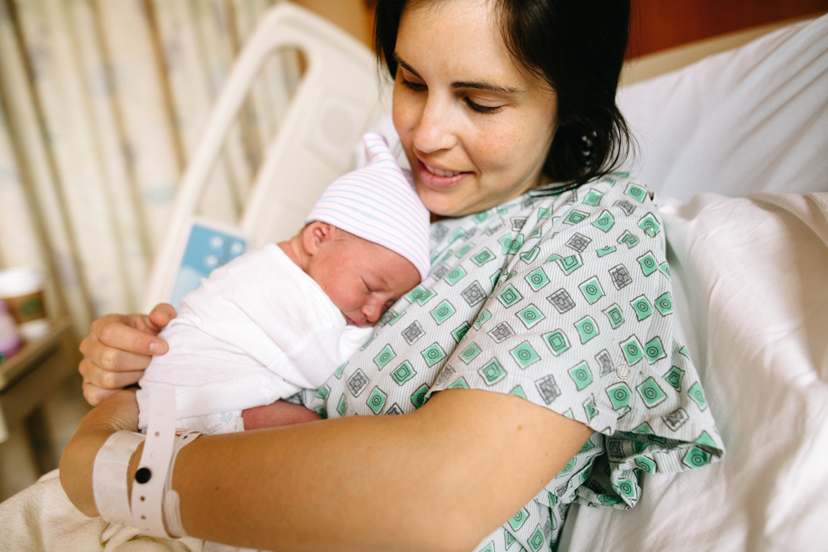
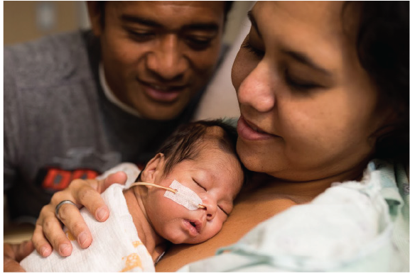
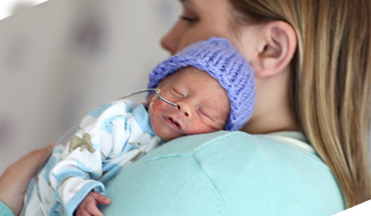
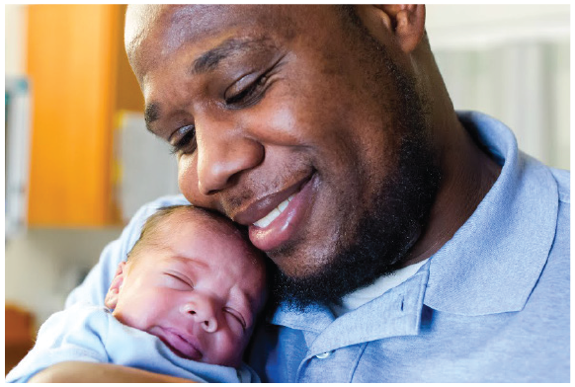
Drive Impact together
Strong Babies
Decorate a Onesie
Grab a fabric marker/pen and an onesie.
Write and design your message choosing from one of our preapproved messages.
Early Bird Special
Nurse Magnet
Work of <3
The snuggle is real
I love my NICU nurse
Rocked the NICU like a boss
From small beginnings come great things
I’m not small, I’m fun sized
Hello! I’m new here
Once you are done, place the completed onesies in the area provided.
Follow us on
© 2018 March of Dimes

